Slide 1

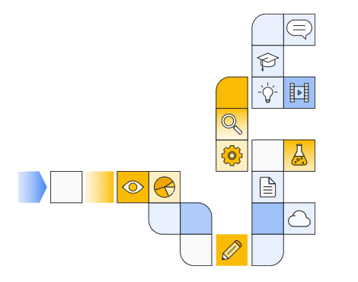

Google cloud generative ai overview Part 5
Notes:
https://www.cloudskillsboost.google/paths/118/course_templates/388

Slide 2
Vertex ai agent builder architecture and security
Notes:
https://www.youtube.com/watch?v=E3KPmIi6Av0
https://www.youtube.com/watch?v=LNGg72OfwdE

Slide 3
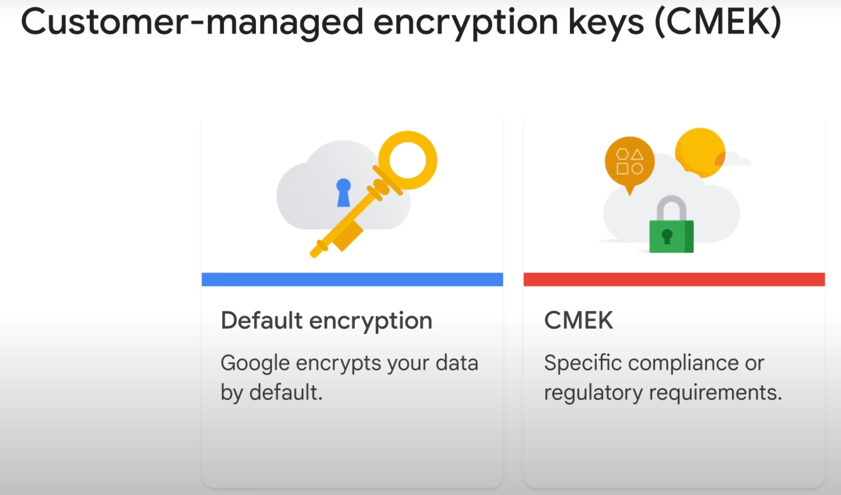

Slide 4
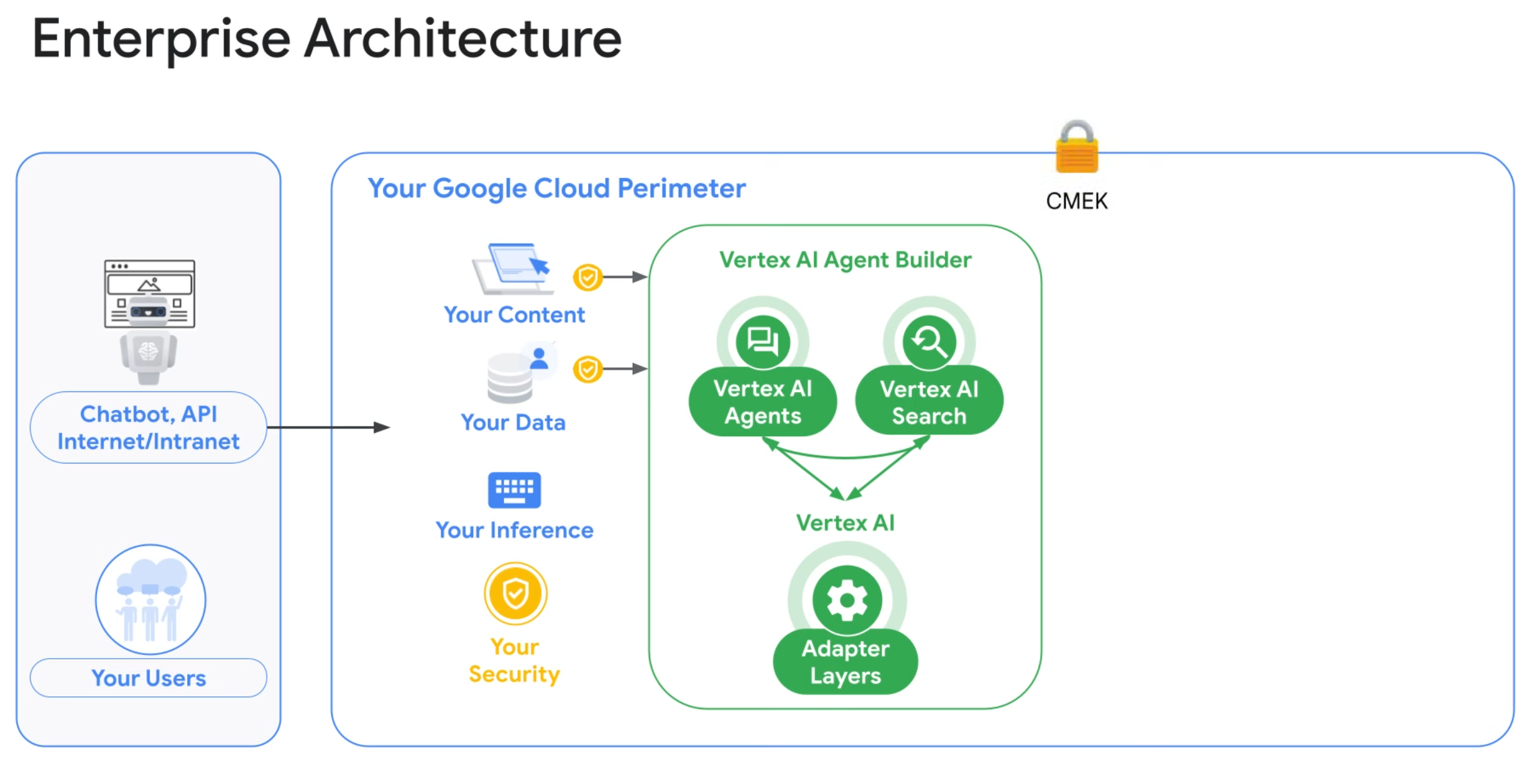

Slide 5
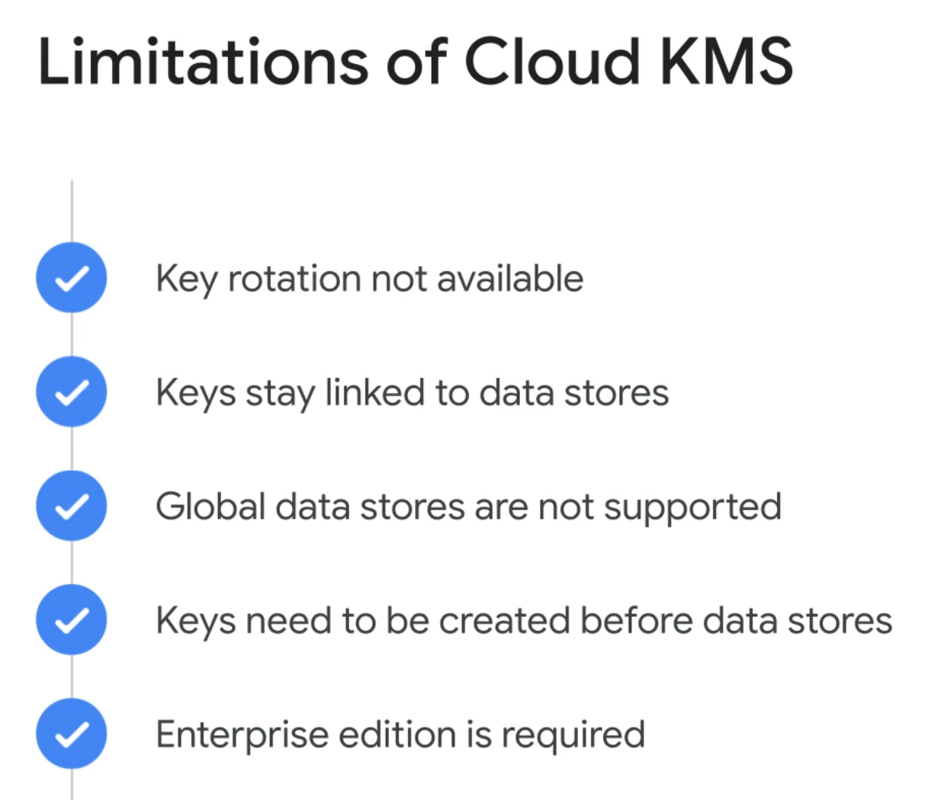

Slide 6
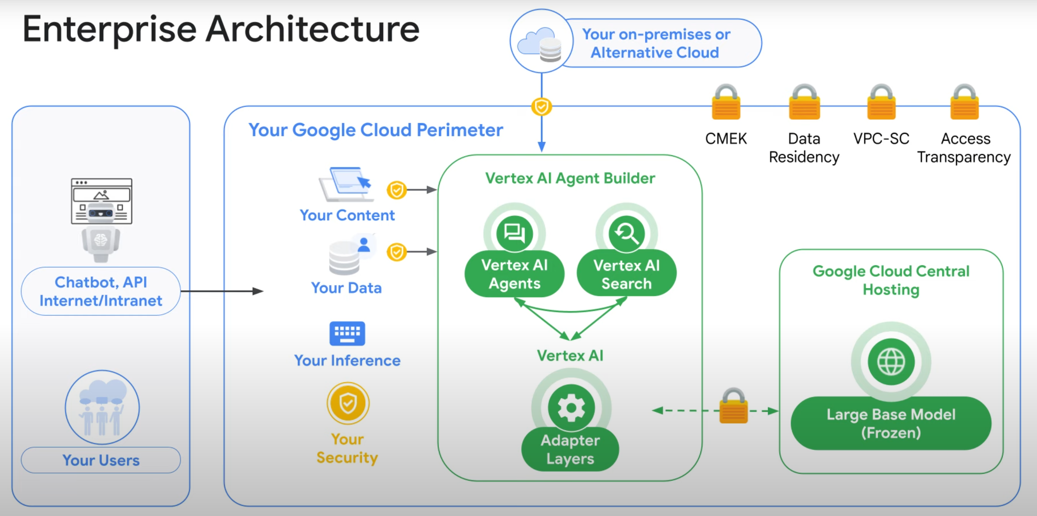

Slide 7
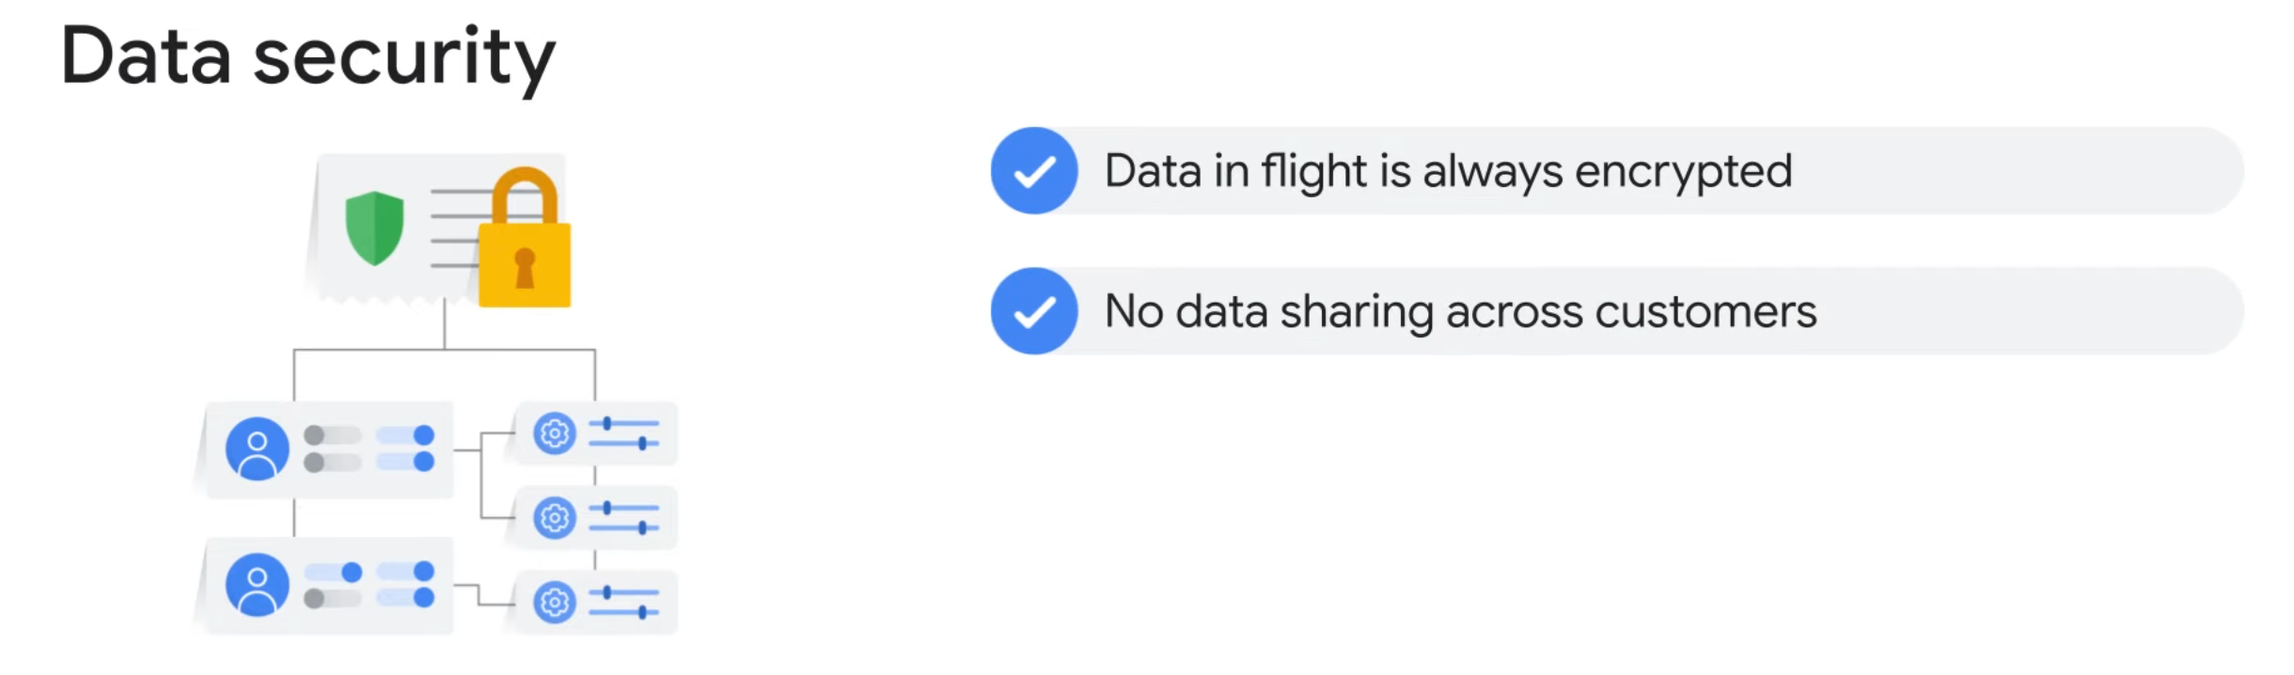

Slide 8
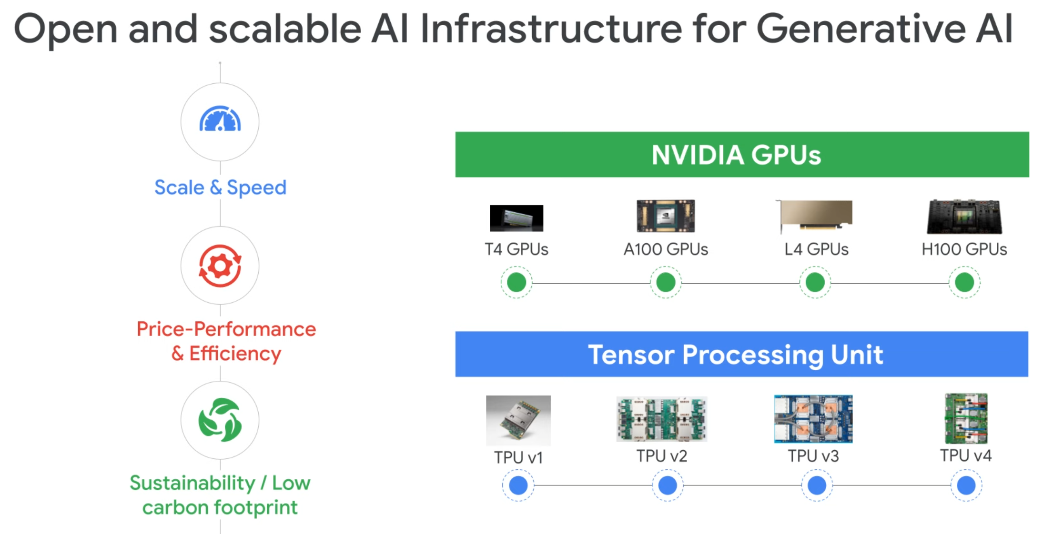

Slide 9
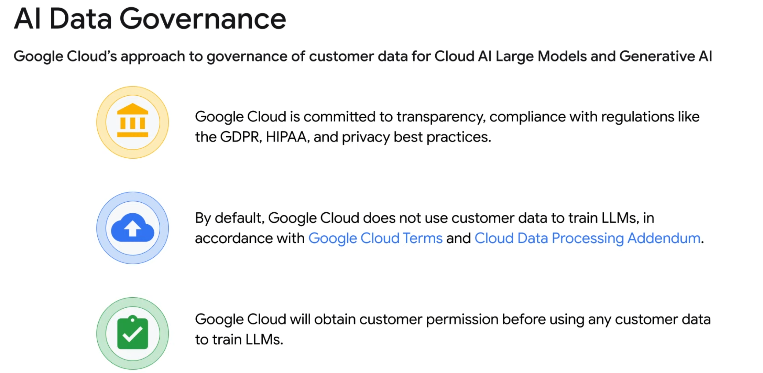

Slide 10
Vertex ai pricing
Notes:
https://www.youtube.com/watch?v=eSmIVzcBiCo
https://www.youtube.com/watch?v=-SoLhFqRagU
https://www.youtube.com/watch?v=cw3tOpRHn4Y

Slide 11
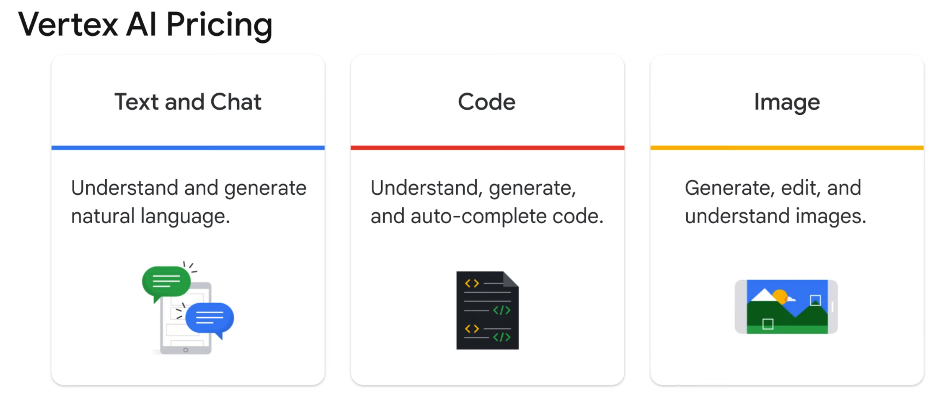

Slide 12
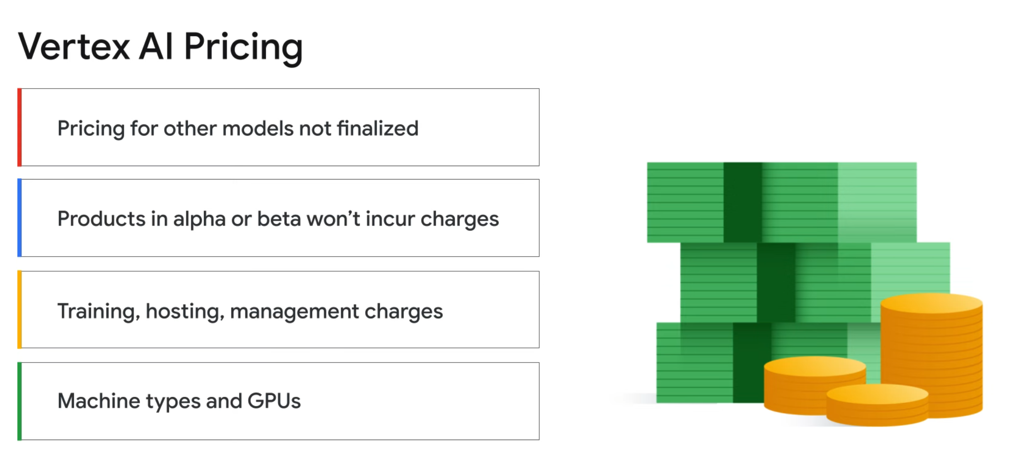

Slide 13
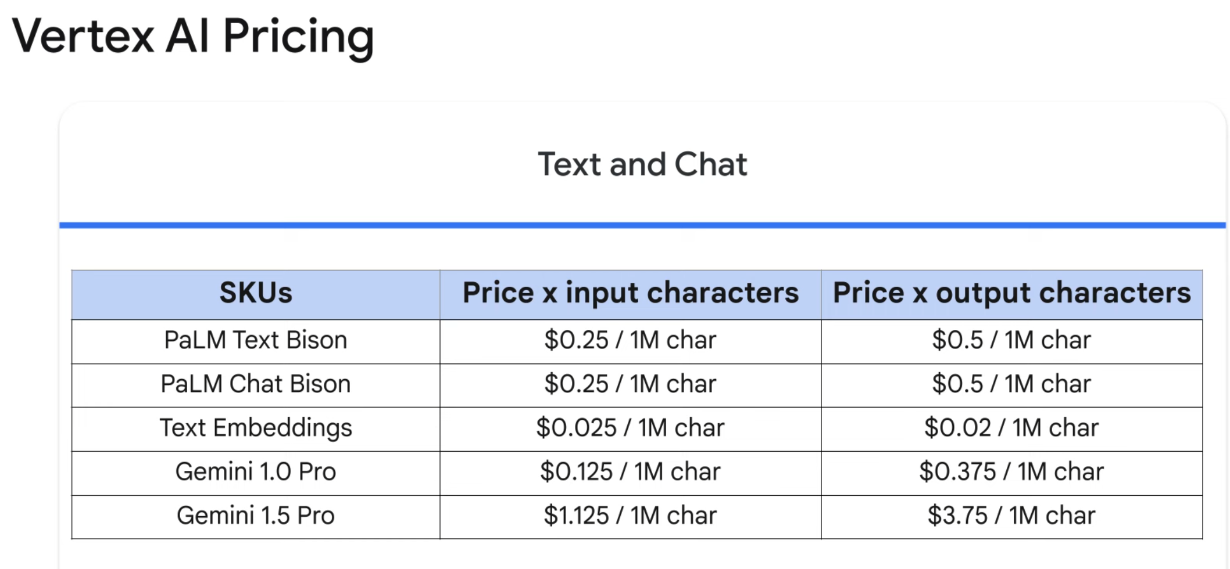
Notes:
https://cloud.google.com/vertex-ai/pricing

Slide 14
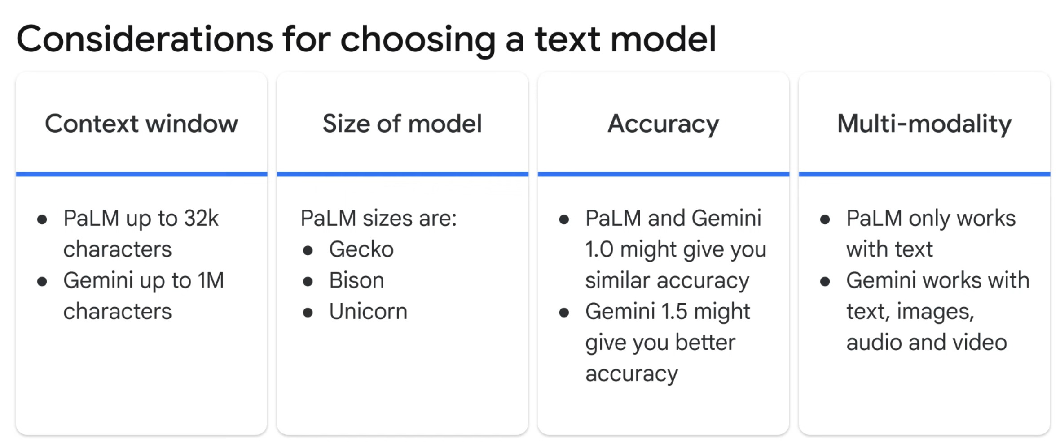

Slide 15
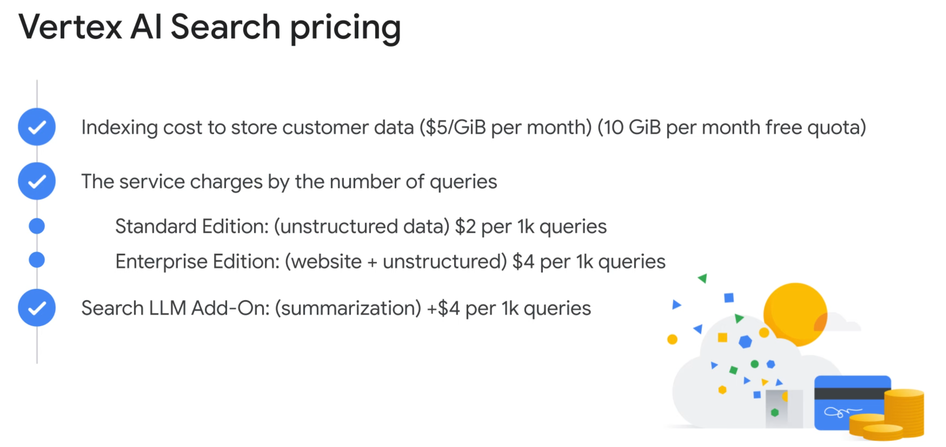

Slide 16
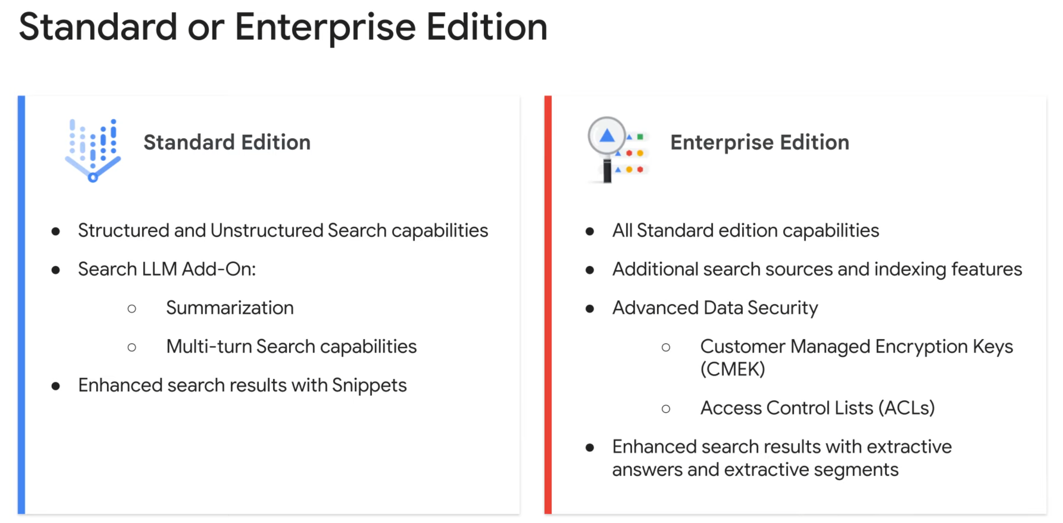

Slide 17
Using Generative ai with your data
Notes:
https://www.youtube.com/watch?v=GLrWkqsAor0

Slide 18
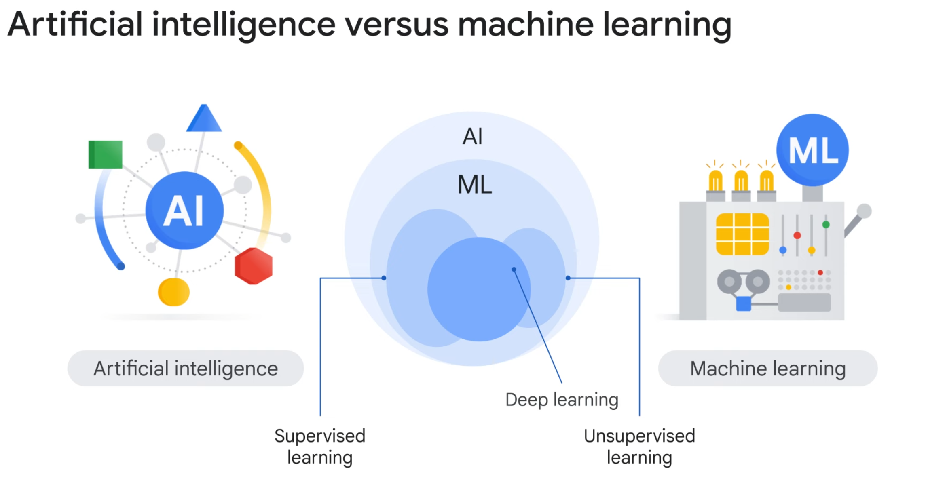

Slide 19
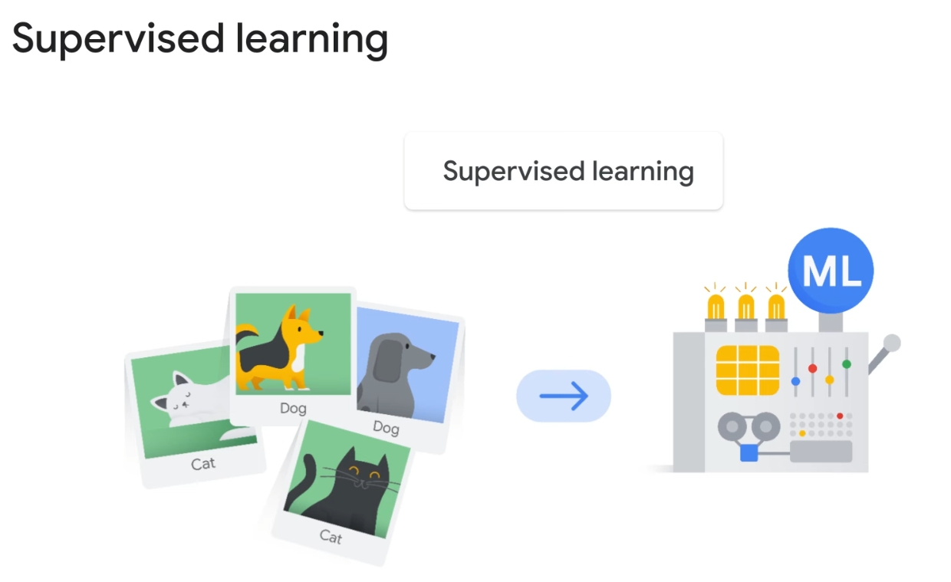

Slide 20
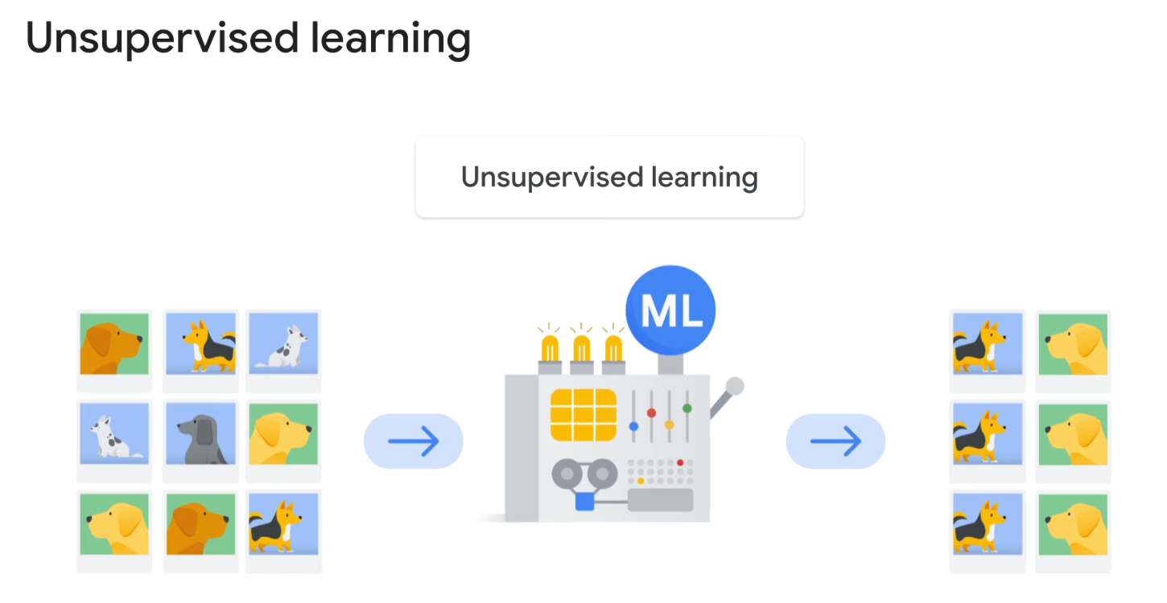

Slide 21
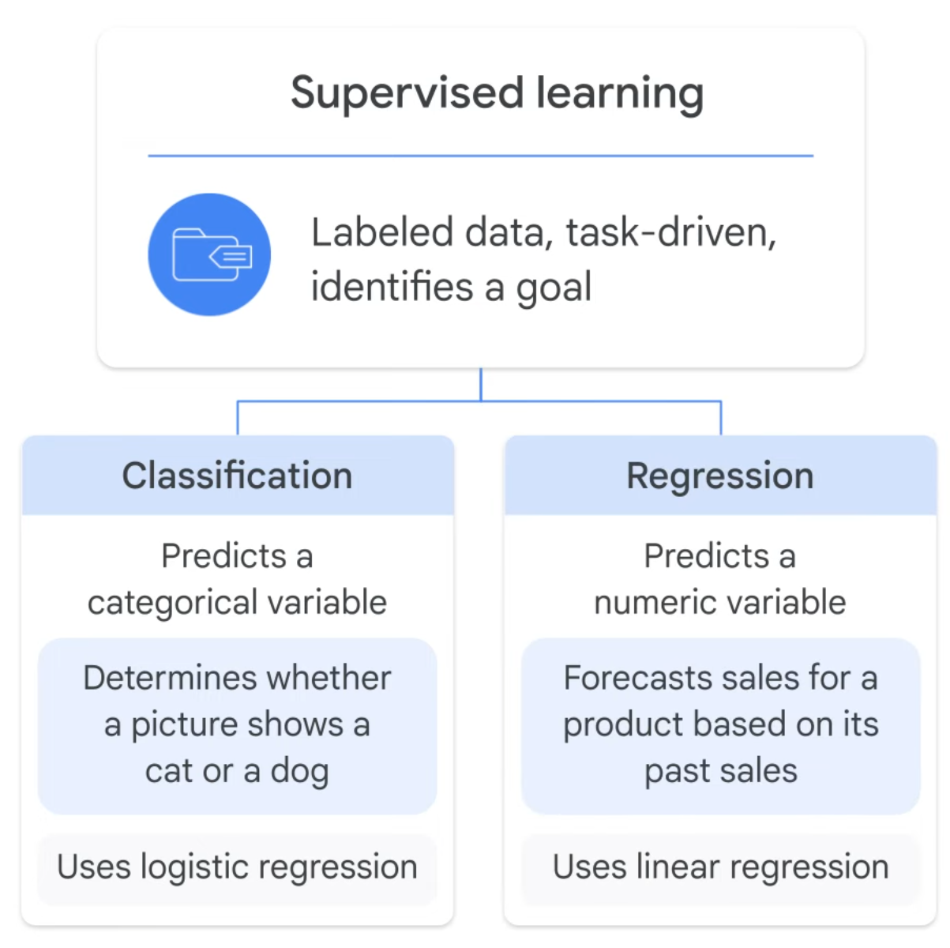

Slide 22
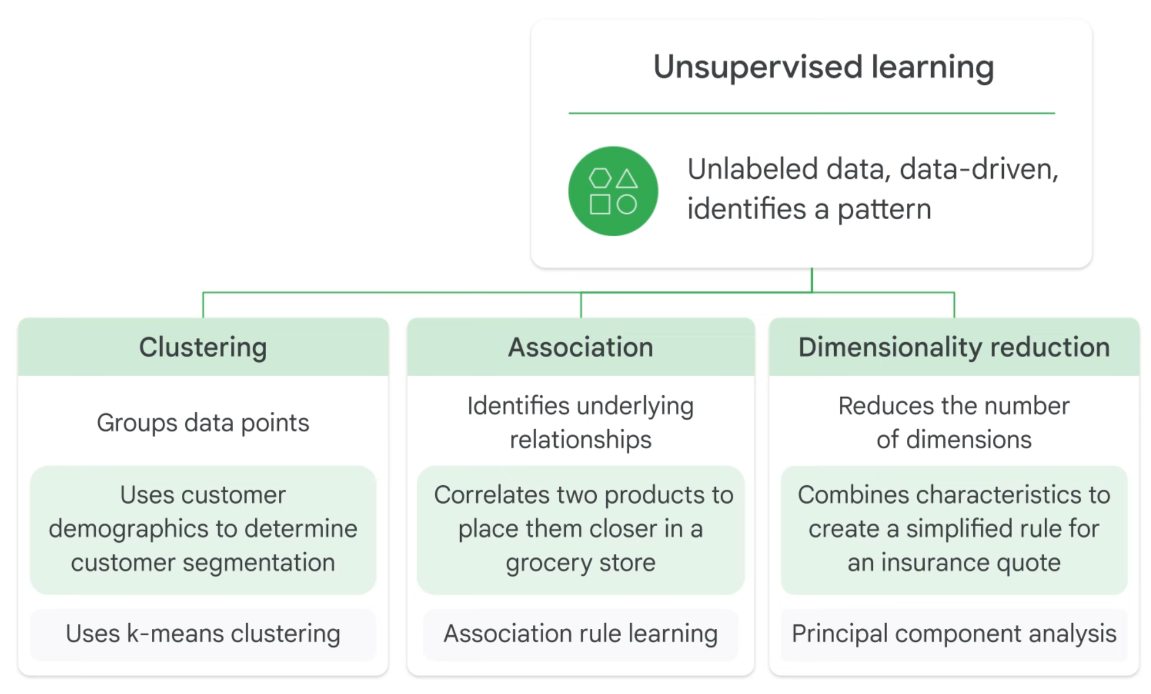

Slide 23
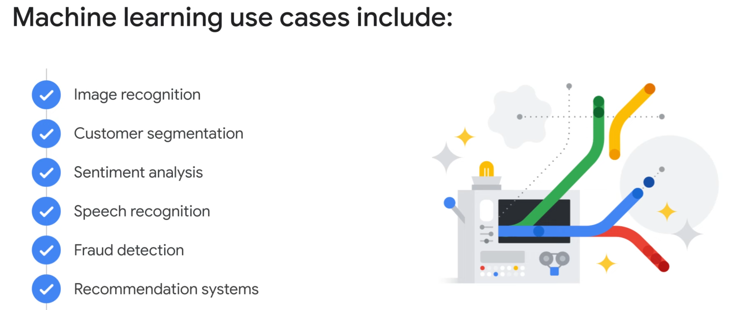

Slide 24
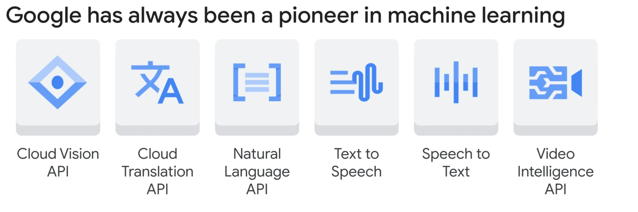

Slide 25
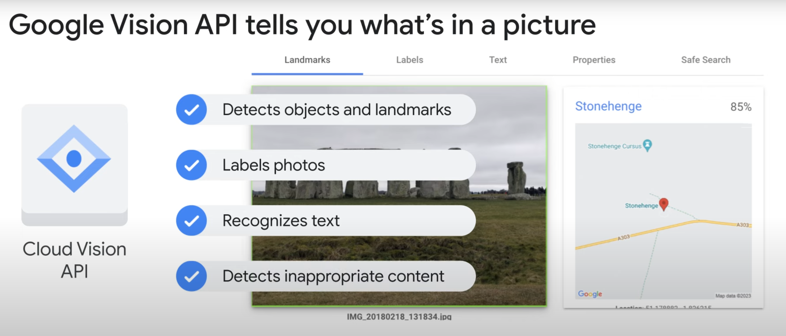

Slide 26
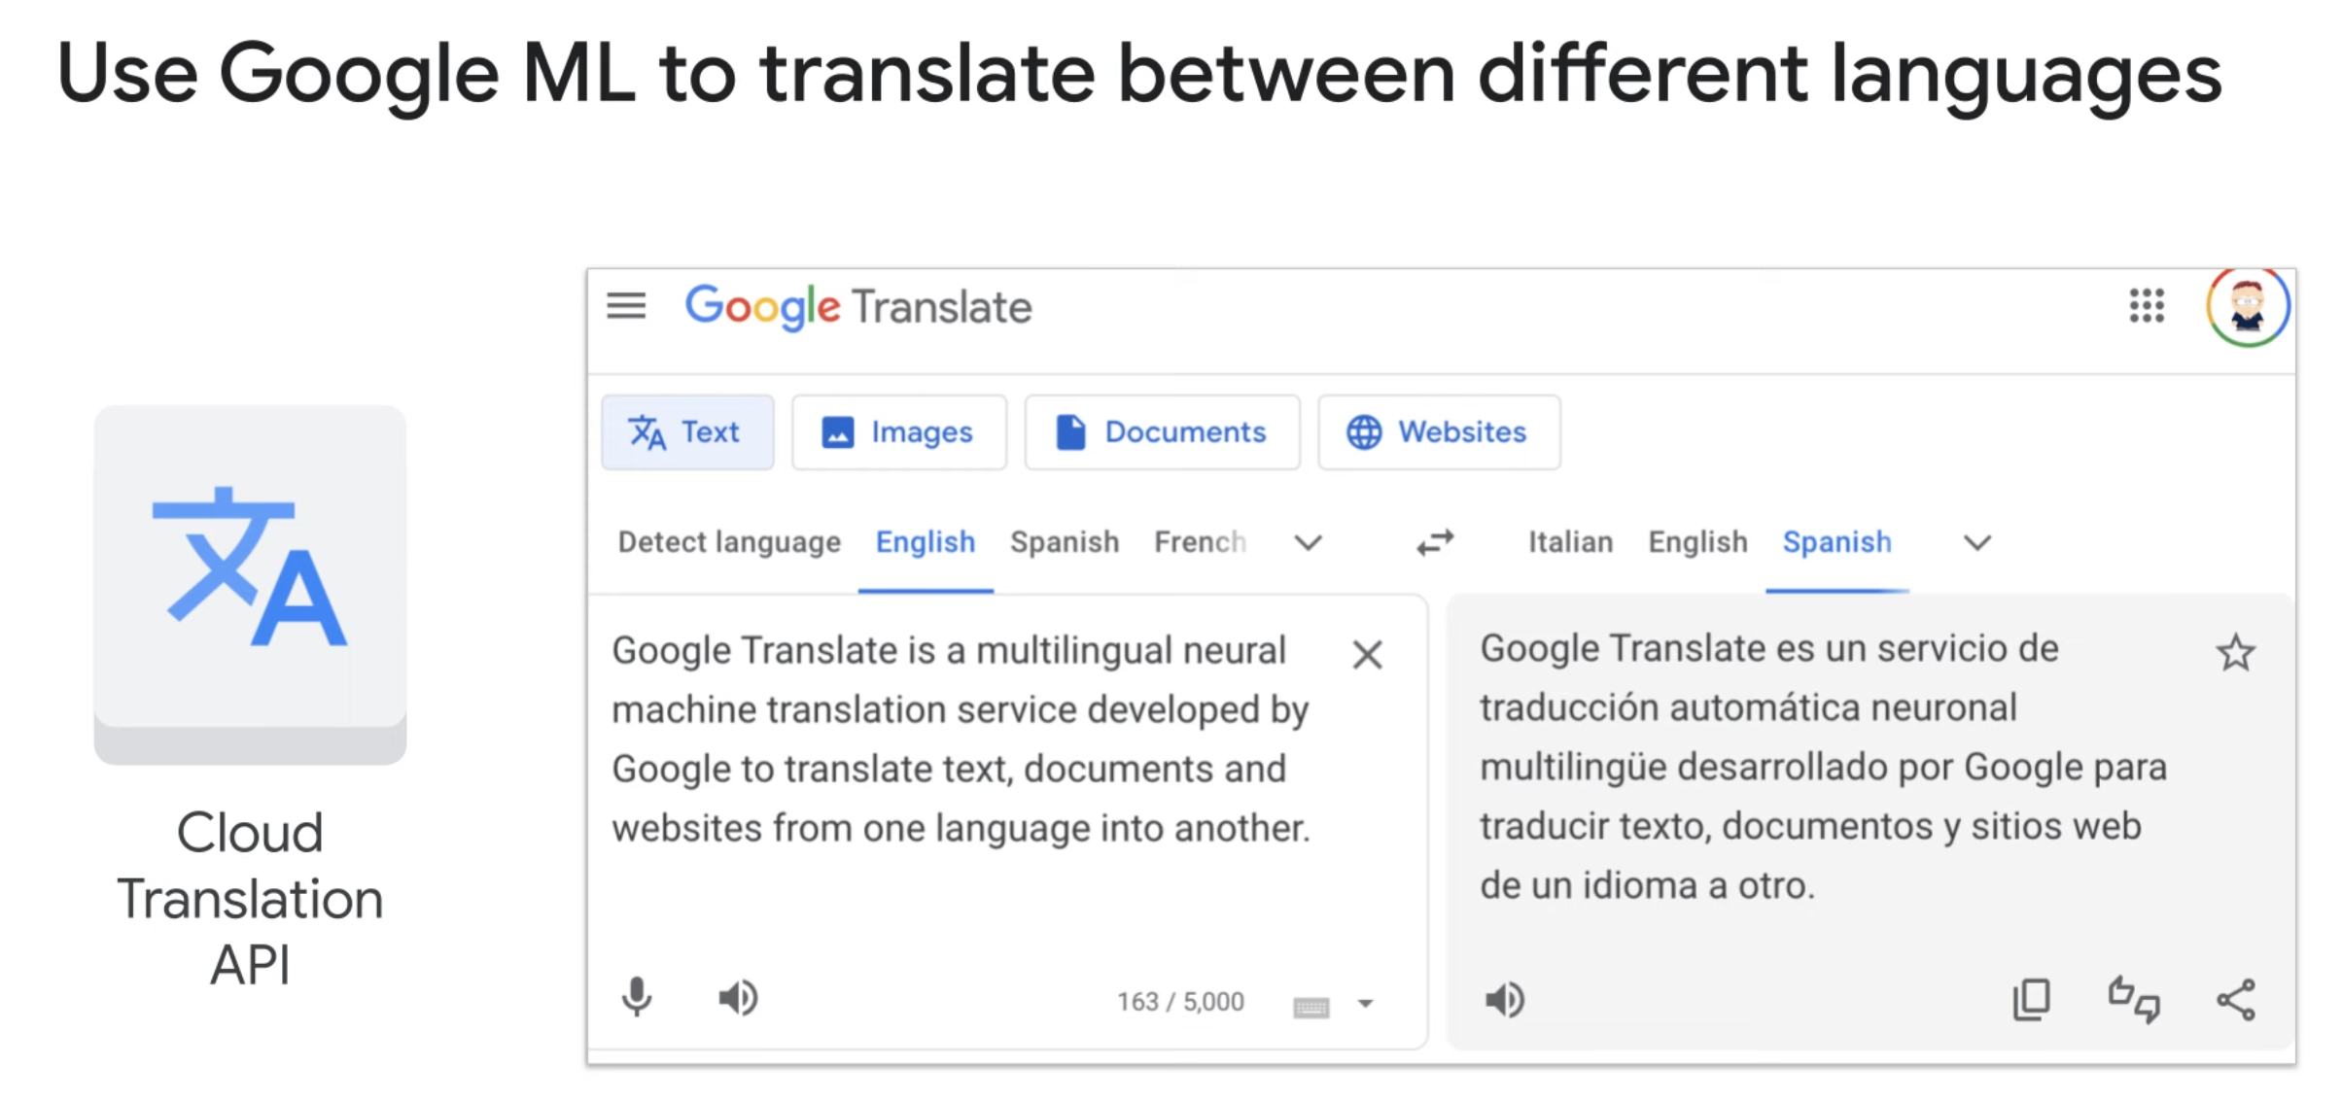

Slide 27
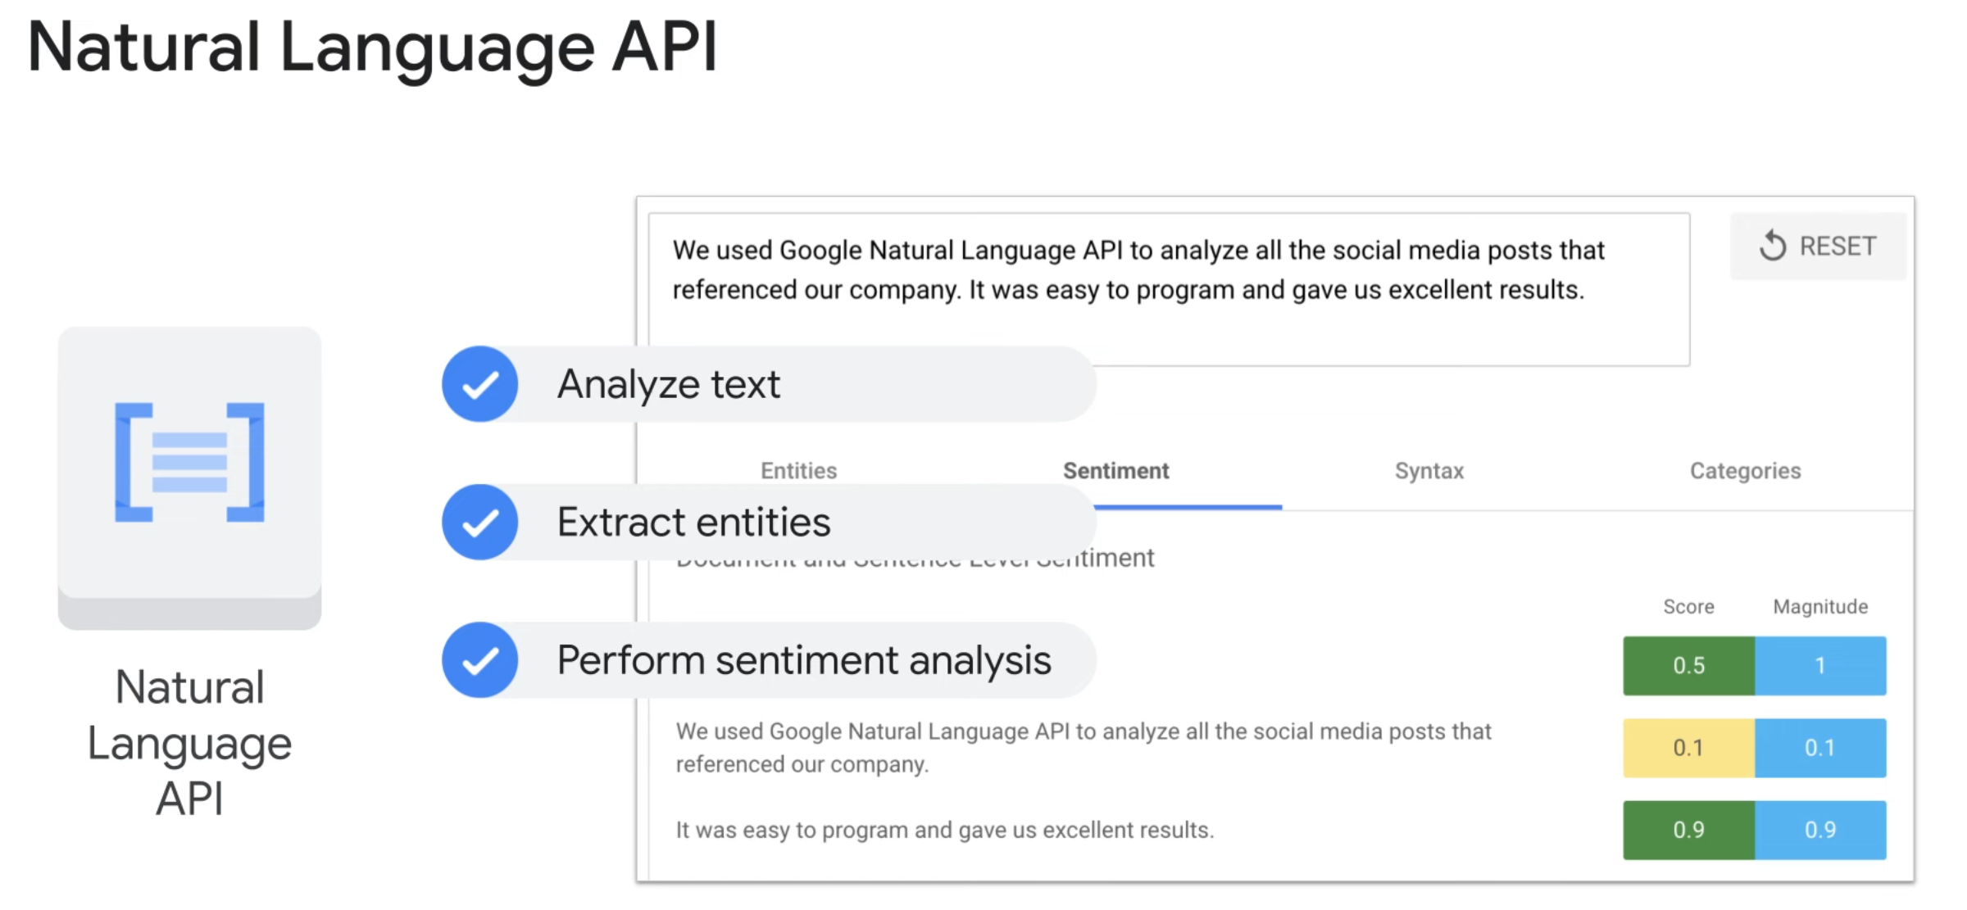

Slide 28


